Slide 1


Credit Card Pilot project Analysis
Where Trust Meets Innovation
Mohammed Hashir

Slide 2
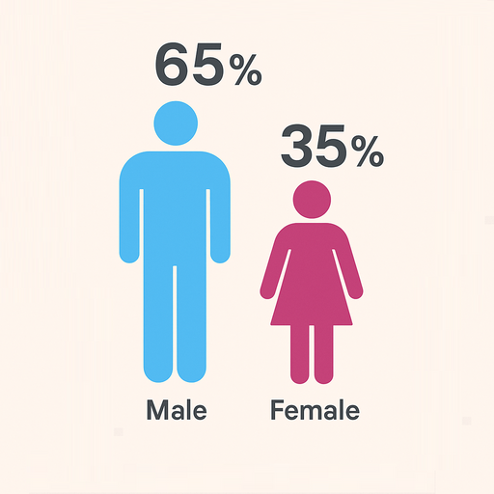
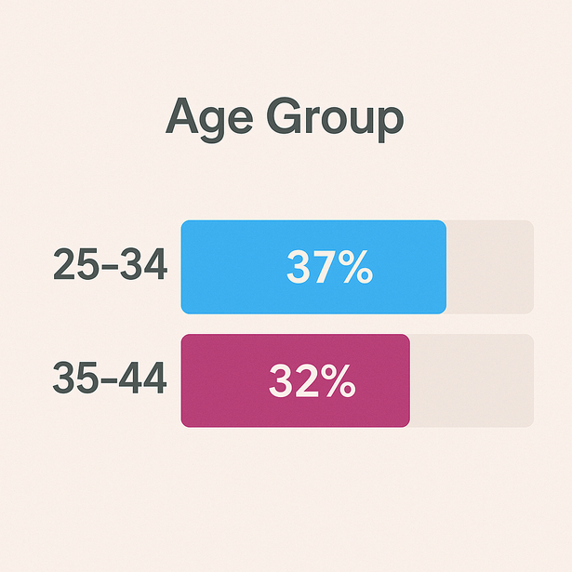
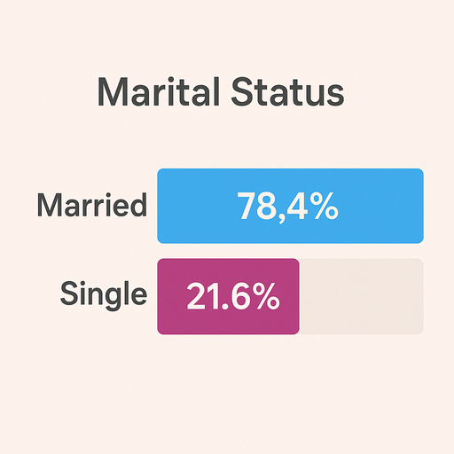
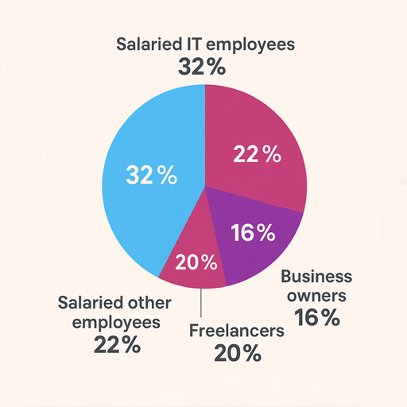
Our
CUSTOMERS

Slide 3
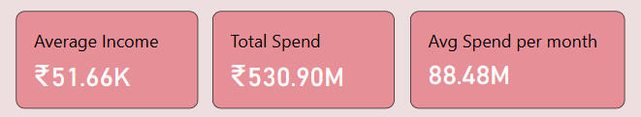
Key
METRICS
Data for 6 months, May - Oct

Slide 4
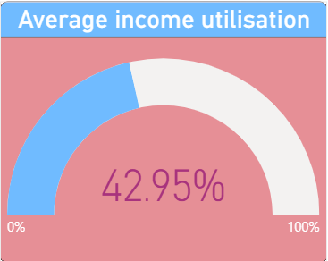
UTILISATION
Income
Lowest Income utilization
Highest Income utilization
Age group : 45 +
Gender : Female
Marital Status : Single
Age group : 35 - 45
Gender : Male
Marital Status : Married
25.88%
58.45%
Data for 6 months, May - Oct

Slide 5
EXPENDITURE
Low Spenders
High Spenders
Age group : 45 +
Gender : Female
Occupation : Govt Employee
Age group : 25 - 45
Gender : Male
Marital Status : Married
3.39 M
37.58 M
Data for 6 months, May - Oct

Slide 6
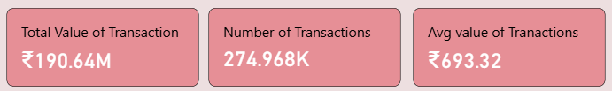
TRANSACTIONS
Data for 6 months, May - Oct

Slide 7
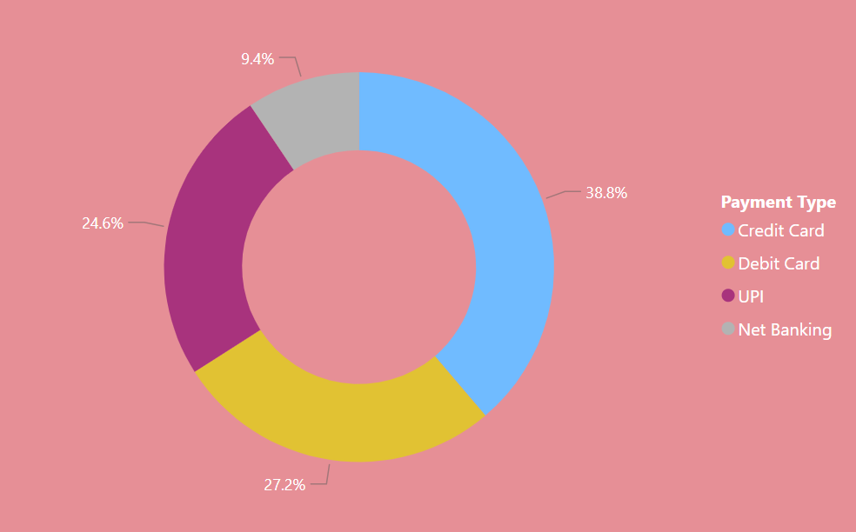
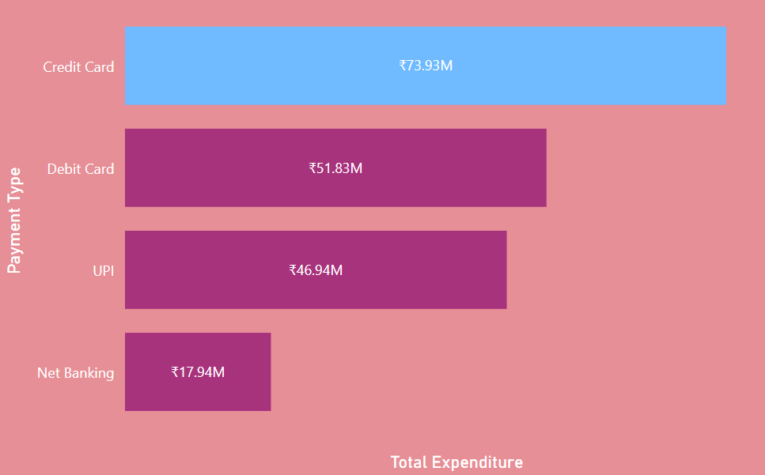
PAYMENT MODE
Data for 6 months, May - Oct

Slide 8
DEBIT CARDS
Preferences
Total Value of Transactions : Rs. 51.83 M
Number of Transactions : 68.74 K
Average value of Transactions : Rs. 753
Data for 6 months, May - Oct

Slide 9
DEBIT CARDS
Preferences
TARGET SEGMENT
Age Group : 35 - 45 years
Occupation : Salaried IT & Other employees
City : Mumbai & Delhi NCR
Category : Groceries, Health & wellness, Travel
Total Value of Transactions : Rs. 51.83 M
Number of Transactions : 68.74 K
Average value of Transactions : Rs. 753

Slide 10
UPI
Preferences
Total Value of Transactions : Rs. 46.94 M
Number of Transactions : 68.74 K
Average value of Transactions : Rs. 682
Data for 6 months, May - Oct

Slide 11
UPI
Preferences
TARGET SEGMENT
Age Group : 21 - 24 years
Occupation : Freelancers & Salaried IT employees
City : Mumbai & Delhi NCR
Category : Groceries, Health & wellness, Travel
Total Value of Transactions : Rs. 46.94 M
Number of Transactions : 68.74 K
Average value of Transactions : Rs. 682

Slide 12
TARGET
Customer Segments
High Spending lifestyle
25 - 45 Years
Salaried IT & other Employees
Focus on Health & Wellness, Travel

Slide 13
TARGET
Customer Segments
High income utilisation
21 - 24 Years
Salaried IT Employees & Freelancers
Focus on Grocery, Health & Wellness

Slide 14
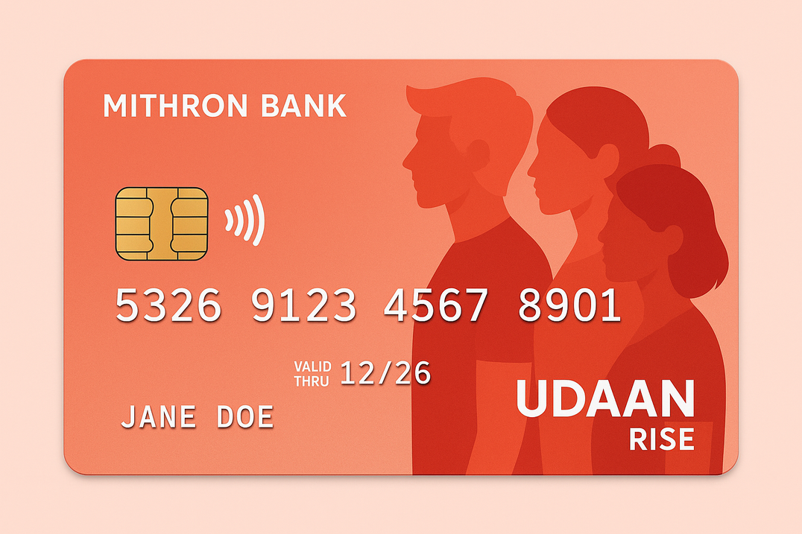
FEATURES
Mithron Udaan Rise
Zero annual charges.
7% on Dining & Shopping.
5% discount on Metro & Air travels.
10 X more rewards on quick commerce payments.
Convert card payments to EMI hassle-free.

Slide 15
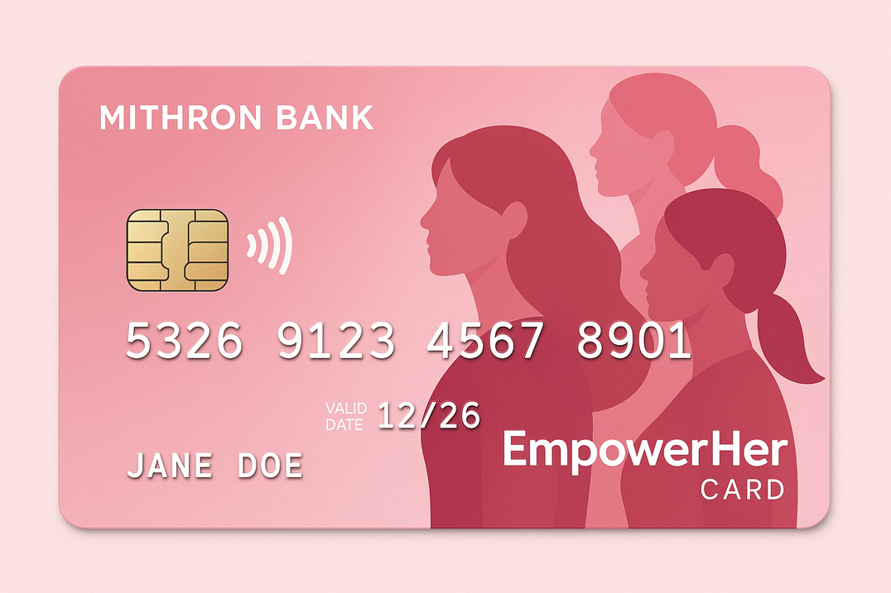
FEATURES
Mithron EmpowerHer Cards
7% Cashback on Health and wellness payments.
Personal loans upto Rs 5 Lakhs based on credit score.
5 % discount on Metro & Air travels.

Slide 16

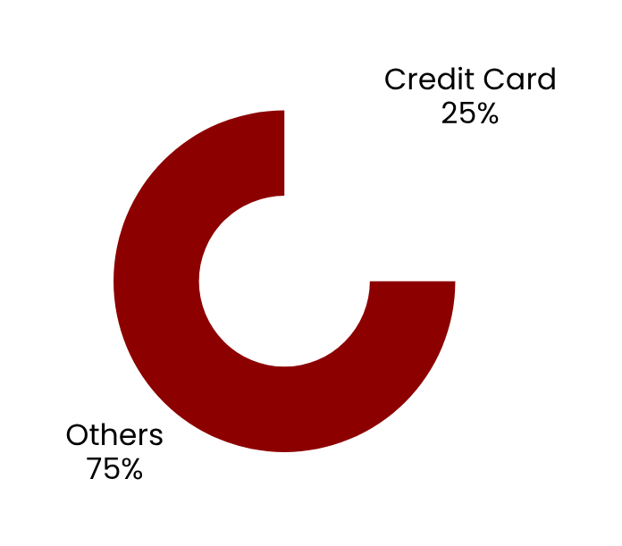
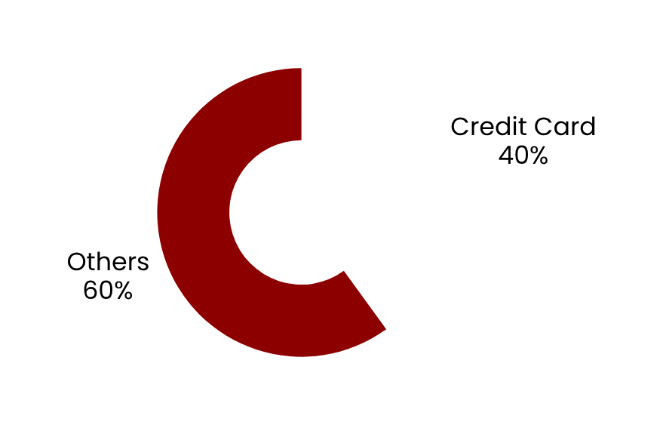
OUTCOMES
Value of Transactions : 31 M
Number of Transactions : 64.8 K
Percentage of CC Transactions: 15%

Slide 17
FUTURE
Scope
Include Credit score of the customers.
Extend the pilot project to tier 2 and tier 3 cities.
Capture more payment methods - ATM withdrawals etc.

Slide 18
Where Trust Meets Innovation
Thank You
Mohammed Hashir

